Slide 1
Plagiarism Detection Dashboard: A Comparative Analysis using NLP
Objective:
Develop an interactive web app to detect plagiarism using three NLP methods:
TF-IDF
Latent Semantic Indexing (LSI)
Sentence-BERT
Goal: Create a smart dashboard to identify verbatim and paraphrased plagiarism efficiently.
Submitted by: Harshal Borse, Manya Mittal
Course Instructor: Dr. Kuntal Dey

Slide 2
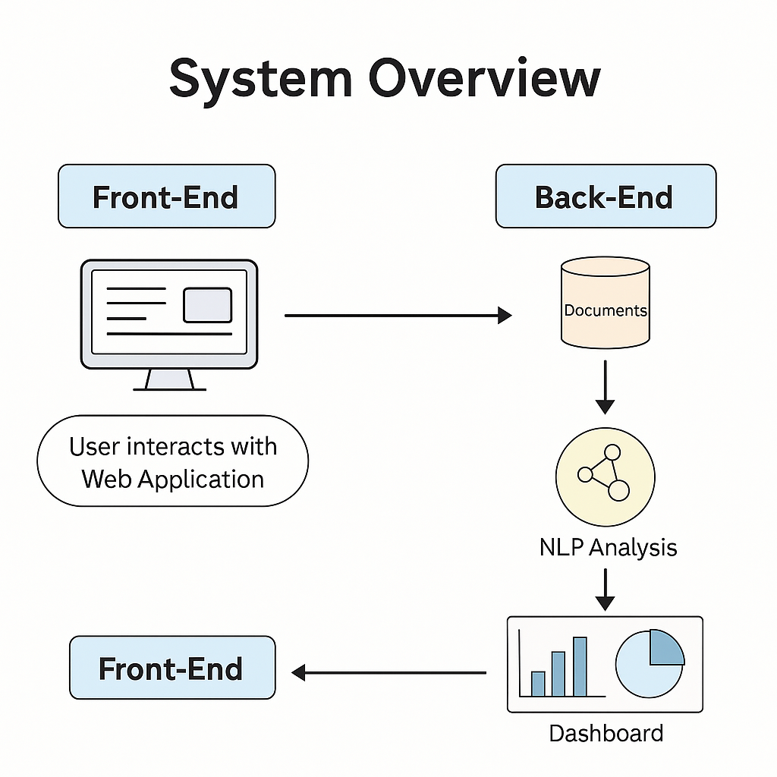
Technology Stack:
Language: Python
Framework: Streamlit
Libraries: scikit-learn, sentence-transformers, Pandas, NumPy, Plotly
Flow Summary:
User uploads text → Model comparison → Results visualization & CSV export.

Slide 3
Methodologies & Comparison
Method | Approach | Best For | Limitation
TF-IDF | Keyword-based | Verbatim plagiarism | Fails with paraphrasing
LSI | Topic modeling via SVD | Synonyms & conceptual similarity | Needs large corpus
Sentence-BERT | Deep semantic embeddings | Paraphrased & restructured text | Computationally heavy

Slide 4
Results & Insights
Method | Similarity Score | Grade
TF-IDF | 52% | Poor
LSI | 78% | Good
Sentence-BERT | 91% | Excellent
Key Takeaway:
Sentence-BERT best captures meaning beyond surface text.
TF-IDF is limited to word-level overlap.

Slide 5
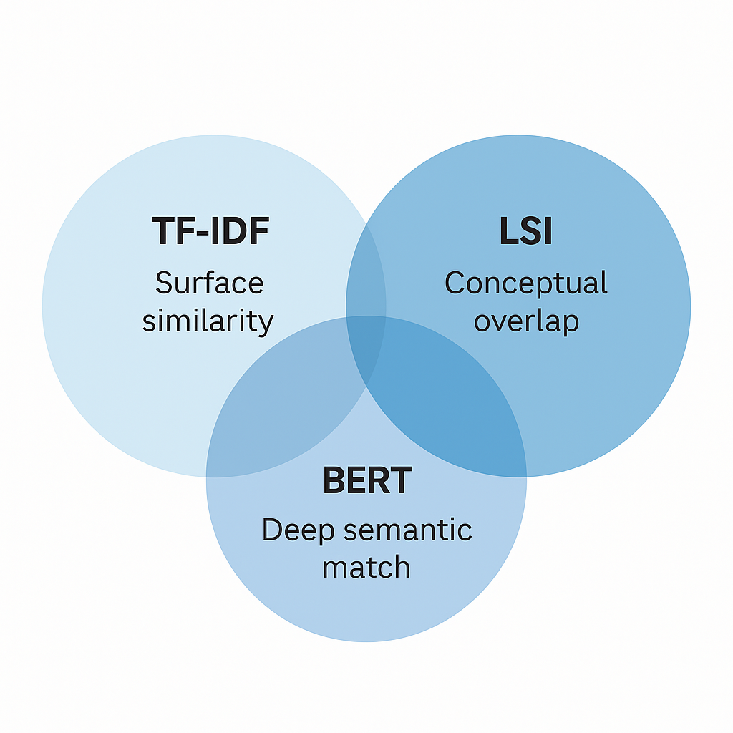
Conclusion
The Plagiarism Detection Dashboard effectively demonstrates:
TF-IDF → surface-level accuracy
LSI → topic-based understanding
Sentence-BERT → semantic-level intelligence
Final Verdict: Sentence-BERT leads the pack for modern, paraphrased plagiarism detection.

